Slide 1
Paper : V2X-ViT: Vehicle-to-Everything Cooperative Perception with Vision Transformer
Runsheng Xu , Hao Xiang , Zhengzhong Tu2, Xin Xia,
Ming-Hsuan Yang, and Jiaqi Ma
8th Aug -2022
Presented by
Naay, Danny
GNR 650

Slide 2
Goal
Perceiving the complex driving environment precisely is crucial to the safety of autonomous vehicles (Avs)
Goal is to develop a robust fusion system to enhance the vehicle’s perception capability and handle real world challenges in a unified end-to-end fashion.
Notes:
To improve the perception performance of autonomous vehicles.

Slide 3
Motivation
Single-vehicle perception systems => Demonstrated significant improvement in several tasks such as semantic segmentation, depth estimation and object detection and tracking
Challenges remain. Single-agent perception system tends to suffer from occlusion and sparse sensor observation at a far distance, which can potentially cause catastrophic consequences.
Vehicle-to-Vehicle (V2V) collaboration => Visual information from multiple nearby AVs are shared for a complete and accurate understanding of the environment.
Challenge remains : This ignores a critical collaborator – roadside infrastructure
Deploying a robust V2X perception system is non-trivial as it forms heterogeneous graph formed by infrastructure and AVs, unlike homogeneous graphs in V2V.
Notes:
(e.g., detection outputs, raw sensory information, intermediate deep learning features, details see Sec. 2)

Slide 4
V2X Challenge
Configuration discrepancies between infrastructure and vehicle sensors, such as types, noise levels, installation height, and even sensor attributes and modality.
GPS localization noises and the asynchronous sensor measurements of AVs and infrastructure can introduce inaccurate coordinate transformation and lagged sensing information.
Asynchronous information sharing, pose errors, and heterogeneity of V2X components

Slide 5
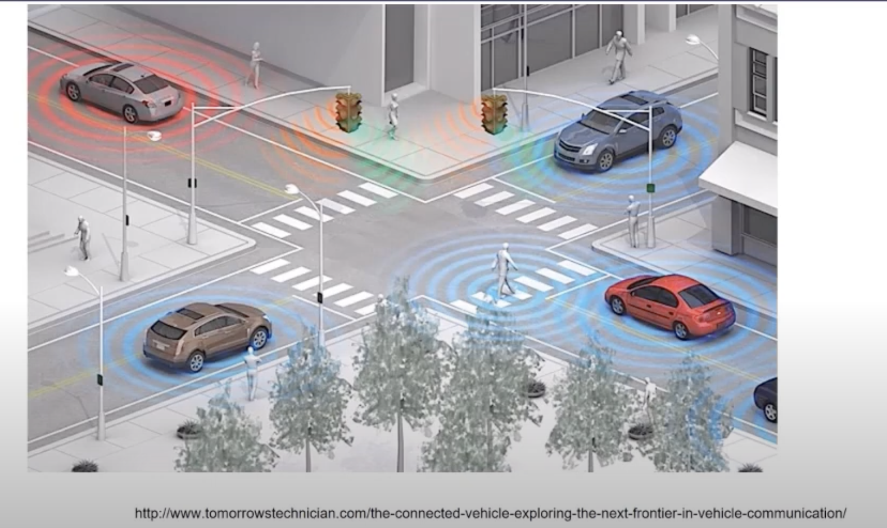
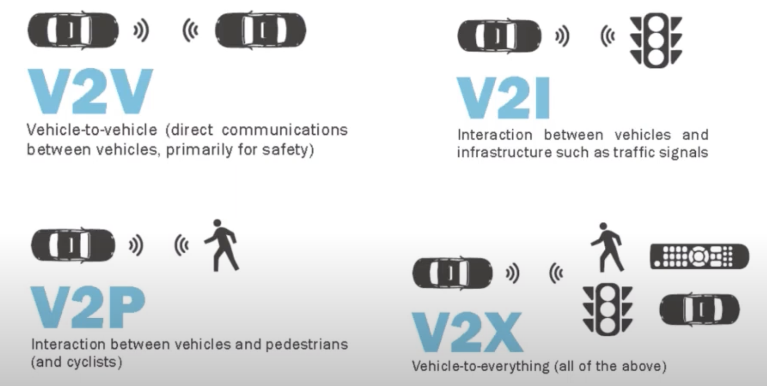
V2X

Slide 6
What is cooperative perception framework
How to efficiently fuse visual cues from neighboring agents.
Based on its message sharing strategy it is divided into 3 categories :
1. Early fusion : Where raw data is shared and gathered to form a holistic view.
2. Intermediate fusion : Where intermediate neural features are extracted based on each agent’s observation and then transmitted.
3. Late fusion : Where detection outputs are shared.
Intermediate fusion has attracted increasing attention because of its good balance between accuracy and transmission bandwidth

Slide 7
What is cooperative perception framework .. cont
Intermediate fusion methods for V2V perception :
OPV2V -> implements a single-head self-attention module to fuse features,
F-Cooper -> employs maxout fusion operation.
V2VNet -> proposes a spatial-aware message passing mechanism to jointly reason detection and prediction.
Here, regresses vehicles localization errors with consistent pose constraints
Most V2X methods explored late fusion strategies to aggregate information from infrastructure and vehicles
Notes:
Two novel attention modules to accommodate V2X challenges:
These two modules will adaptively iteratively fuse visual features to capture
inter-agent interaction and per-agent spatial relationship correcting the feature misalignment caused by localization error and time delay.
All these modules are incorporated in a single transformer that learns to address these challenges end-to-end.

Slide 8
What is cooperative perception framework .. Alternative
LiDAR-based 3D object detection:
Numerous methods have been explored to extract features from raw points, voxels, bird-eye-view (BEV) images, and their mixtures.
PointRCNN proposes a two-stage strategy based on raw point clouds, which learns rough estimation in the first stage and then refines it with semantic attributes.
Despite having high accuracy, their inference speed and memory consumption are difficult to optimize due to reliance on 3D convolutions.
Notes:
Two novel attention modules to accommodate V2X challenges:
These two modules will adaptively iteratively fuse visual features to capture
inter-agent interaction and per-agent spatial relationship correcting the feature misalignment caused by localization error and time delay.
All these modules are incorporated in a single transformer that learns to address these challenges end-to-end.

Slide 9
Solution - Scope
V2X – VIT :
Here, AVs and Infrastructure capture, encode, compress, and send intermediate visual features with each other, while the ego vehicle (i.e., receiver) employs V2X-Transformer to perform information fusion for object detection
1) A customized heterogeneous multi-agent self-attention module that explicitly considers agent types (vehicles and infrastructure) and their connections when performing attentive fusion.
2) A multi-scale window attention module that can handle localization errors by using multi-resolution windows in parallel.
3) Also integrate a delay-aware positional encoding to handle the time
delay uncertainty further.
Notes:
Two novel attention modules to accommodate V2X challenges:
These two modules will adaptively iteratively fuse visual features to capture
inter-agent interaction and per-agent spatial relationship correcting the feature misalignment caused by localization error and time delay.
All these modules are incorporated in a single transformer that learns to address these challenges end-to-end.

Slide 10
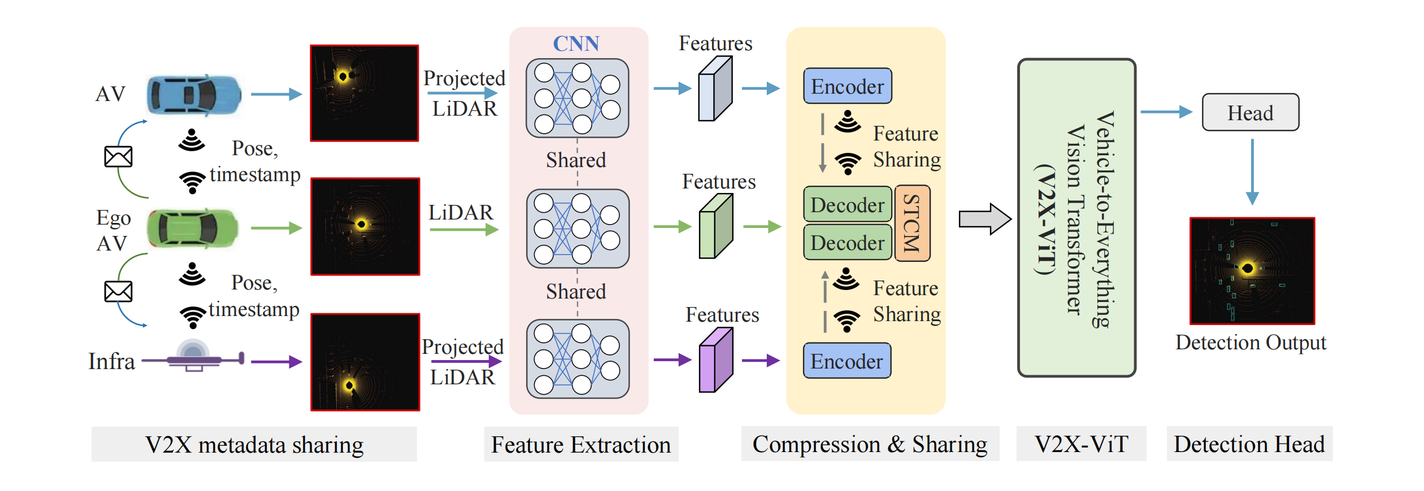
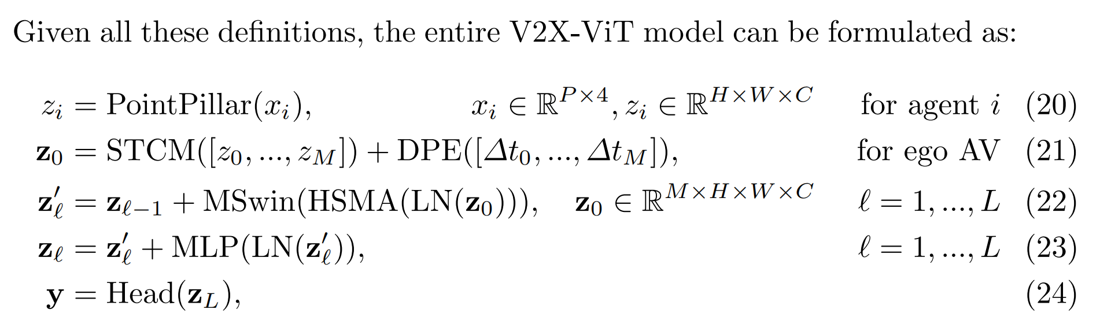
V2X -ViT
Notes:
, composed of a linear projection and a learnable embedding

Slide 11
Why NOT ViT
The full self attention in ViT ,
> having global interaction,
> locality into self-attention, such as Swin, CSwin, Twins, window, and sparse attention.
However, their efficacy to represent heterogeneous graphs has been less studied.
Notes:
Two novel attention modules to accommodate V2X challenges:
These two modules will adaptively iteratively fuse visual features to capture
inter-agent interaction and per-agent spatial relationship correcting the feature misalignment caused by localization error and time delay.
All these modules are incorporated in a single transformer that learns to address these challenges end-to-end.

Slide 12
Scope
Build a robust cooperative perception framework with V2X communication using a novel Vision Transformer. Build a holistic attention model, namely V2X-ViT, to effectively fuse information across on-road agents namely AV and Infrastructure
V2X-ViT consists of alternating layers of:
> heterogeneous multiagent self-attention and
> multi-scale window self-attention,
Inspired by Hetrogeneous Graph Transfomer, build a customized heterogeneous multi-head self-attention module tailored for graph attribute-aware multi-agent 3D visual feature fusion, which is able to capture the heterogeneity of V2X systems.
Also, handle the imperfect localization and time delay exists during feature transmission

Slide 13
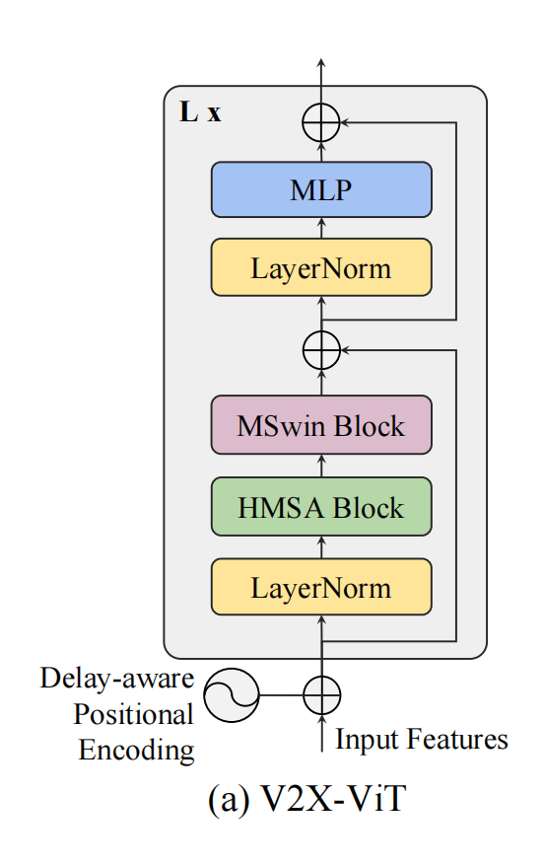
Architecture At A Glance
5 components
Metadata sharing,
Feature extraction,
Compression and sharing
V2X vision Transformer and
Detection head

Slide 14
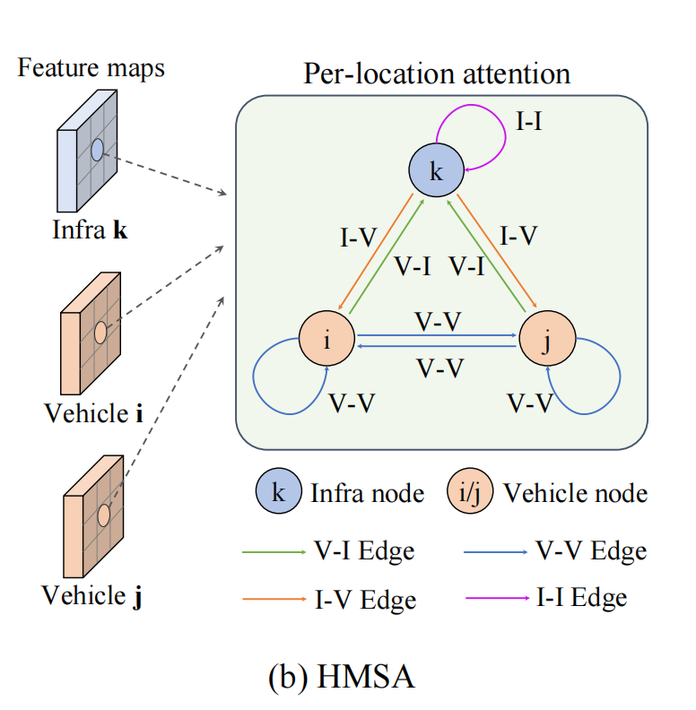
V2X – ViT Architecture
Heterogeneous multi-agent self-attention :: HMSA
Learns different relationships based on node and edge types to effectively capture the heterogeneous graph representation
We have two types of nodes {I, V} and four types of edges {V-V, V-I, I-V, I-I}
Unlike traditional attention where the node features are treated as a vector.

Slide 15
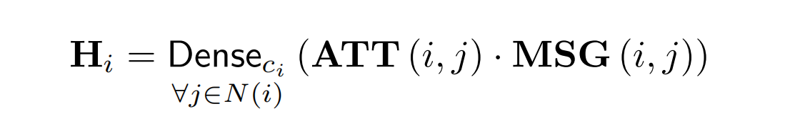
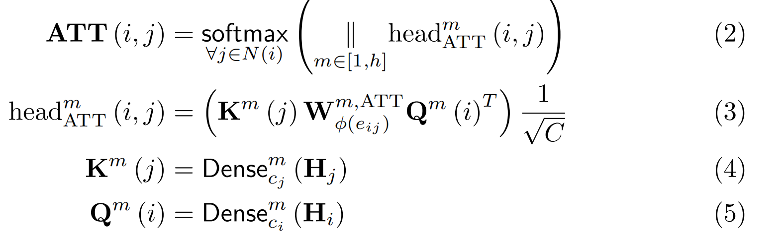
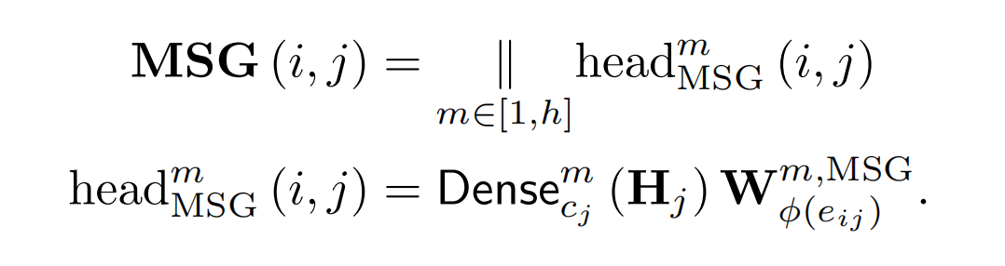
V2X – ViT Architecture - HSMA
To incorporate the semantic meaning of edges we multiple with weight
Separate Dense model for each vehicle
and infrastructure
Matrix to is used to project the features based on the edge type between source node and target node
Linear Aggregator/Projectors indexed by node : Dense [ci]
Attention calculates important weights between pair of nodes based on edges : ATT
Message Aggregator : MSG

Slide 16
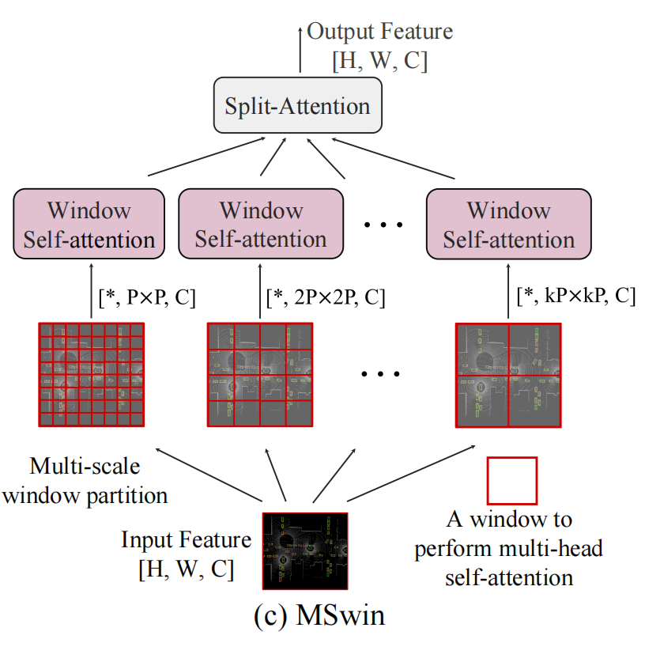
V2X – ViT Architecture
Multi-scale window attention : (Mswin)
New type of attention mechanism tailored for efficient long-range spatial interaction on high-resolution detection.
MSwin uses multiple window sizes to aggregate spatial information, which greatly improves the detection robustness against localization errors.

Slide 17
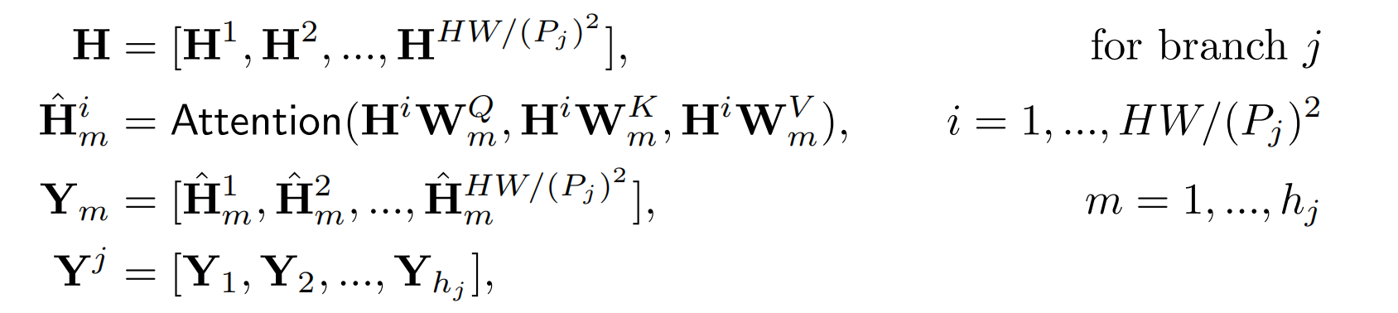
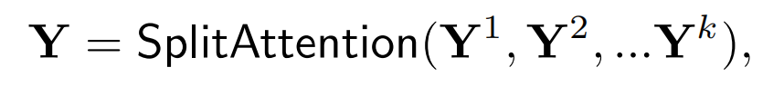
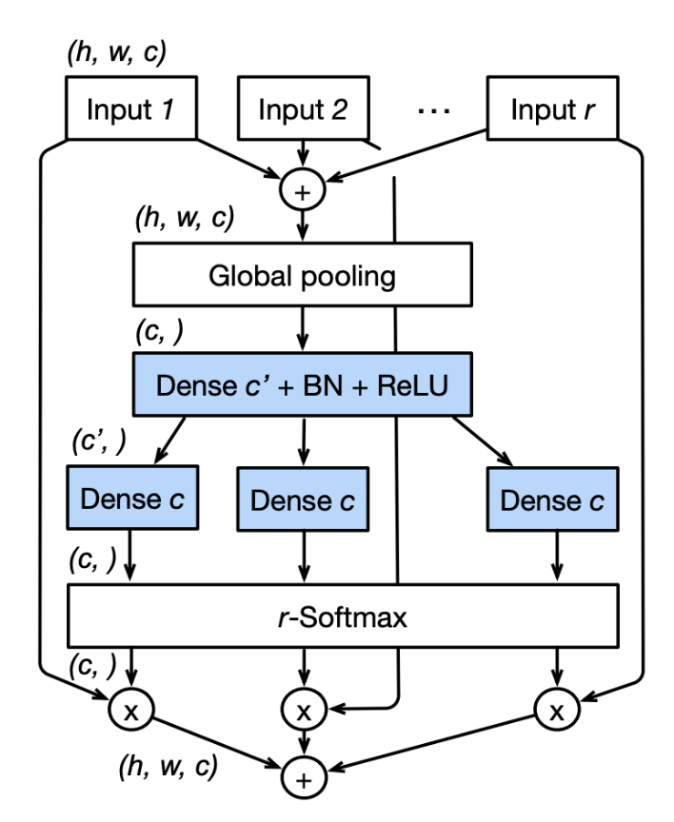
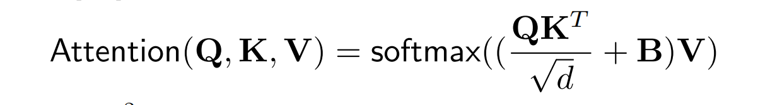
V2X – ViT Architecture - MSWIM
H be an input feature of a single agent
H [i,m ] is the self attention for each branch
Y[m] is the output of the m-th head for branch j.
Y [j] the outputs for all heads 1, 2, ..., hj are concatenated
The Attention is alike Swin, which denotes relative self-attention
The Split Attention block enables attention across feature-map groups.

Slide 18
V2X – ViT Architecture
Delay-aware positional encoding:
To encode this temporal information, we leverage an adaptive delay-aware positional encoding (DPE), composed of a linear projection and a learnable embedding.
We initialize it with sinusoid functions conditioned on time delay and channel and then a linear projection will further warp the learnable embedding so it can generalize better for unseen time delay.
We add this projected embedding to each agents’ feature before feeding into the Transformer so that the features are temporally aligned beforehand

Slide 19
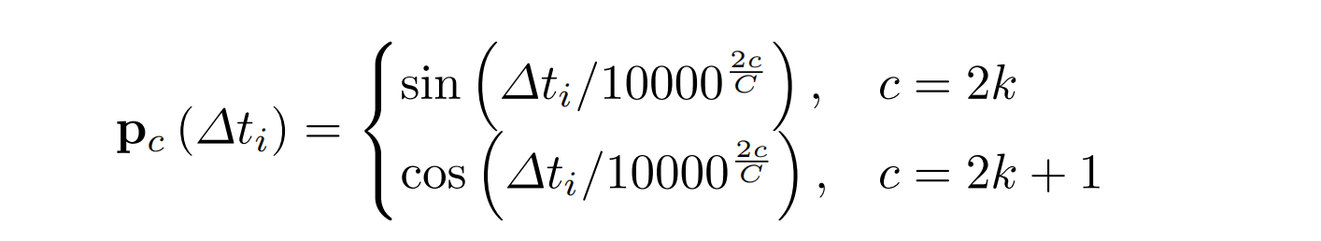
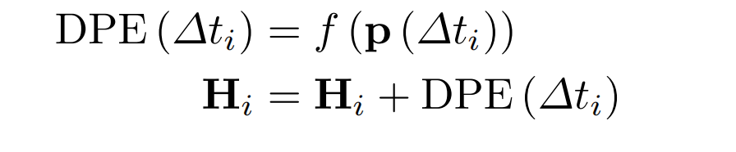
V2X – ViT Architecture
Function f will further warp the learnable embedding so it can generalize better for unseen time delay.
We add this projected embedding to each agents’ feature Hi before feeding to the Transformer

Slide 20
Test Data under 2 settings
Novel large-scale V2X perception dataset using that explicitly considers real-world noises during V2X communication, using the high-fidelity simulator CARLA &
Cooperative driving automation simulation tool OpenCDA
In total, there are 11,447 frames in our dataset (33,081 samples if we count frames per agent in the same scene), and the train/validation/test splits are 6,694/1,920/2,833, respectively
Adam optimizer with an initial learning rate of 0.001 and steadily decay it every 10 epochs using a factor of 0.1.
All models are trained on Tesla V100.
1) Perfect Setting, where the pose is accurate, and everything is synchronized across agents;
2) Noisy Setting, where pose error and time delay are both considered

Slide 21
Test Data under 2 settings .. cont
The communication range of each agent is set as 70 m, whereas all the agents out of this broadcasting radius of ego vehicle is ignored.
During Training - A random AV is selected as the ego vehicle,
During Testing - Evaluate on a fixed ego vehicle for all the compared models.
For the PointPillar backbone, we set the voxel resolution to 0.4 m for
both height and width
Our V2X-ViT has 3 encoder layers with 3 window sizes in MSwin: 4, 8, and 16

Slide 22
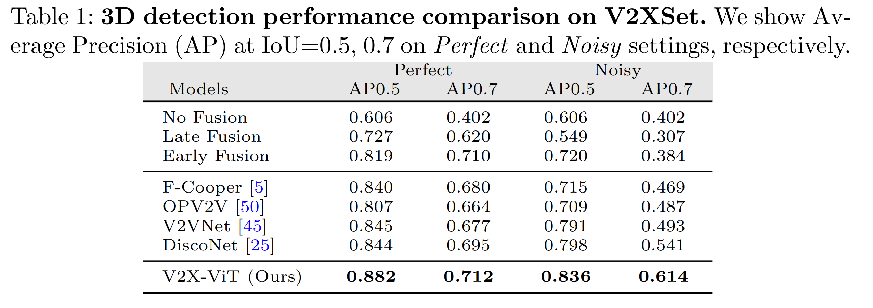
Results
Experimental results demonstrate that V2XViT sets new state-of-the-art performance for 3D object detection and achieves robust performance even under harsh, noisy environments.
The detection performance is measured with Average Precisions (AP) at Intersection-over-Union (IoU) thresholds of 0.5 and 0.7

Slide 23
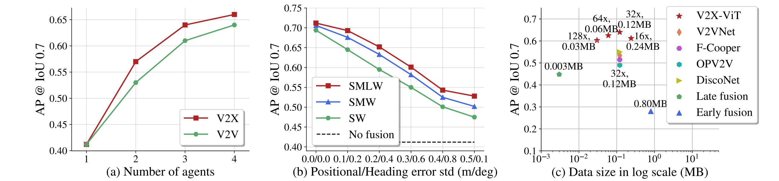
Quantitative evaluation
Note :
b:
i) using a single small window branch (SW),
ii) using a small and a middle window (SMW), and
iii) using all three window branches (SMLW).
c:
With the default compression rate (32x), our V2X-ViT outperforms other intermediate fusion methods substantially;
Even under a 128x compression rate, our model can still maintain high performance.
[V2X-ViT is insensitive to large compression rate.]
Notes:
using a single small window branch

Slide 24
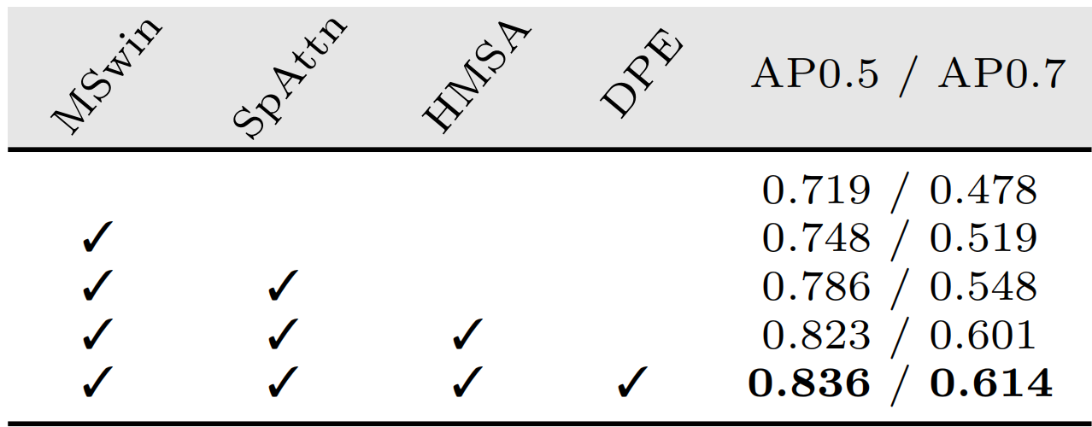
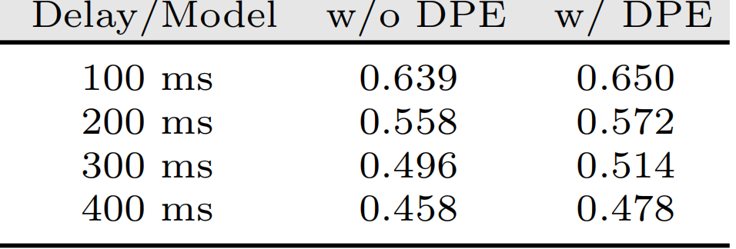
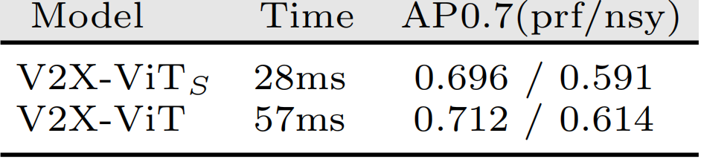
Ablation Studies
Component ablation study
Effect of DPE w.r.t. time delay
Inference Time measurement
1 encoder
3 encoders

Slide 25
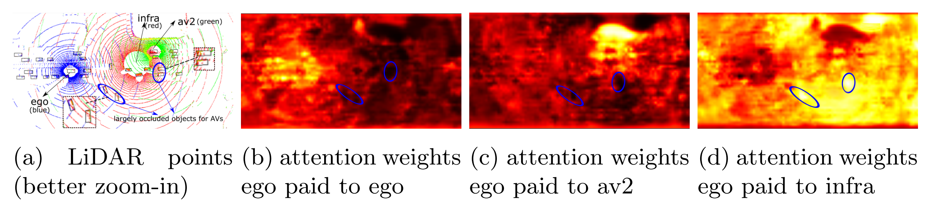
Qualitative evaluation
Aggregated LiDAR points and attention maps for ego.

Slide 26
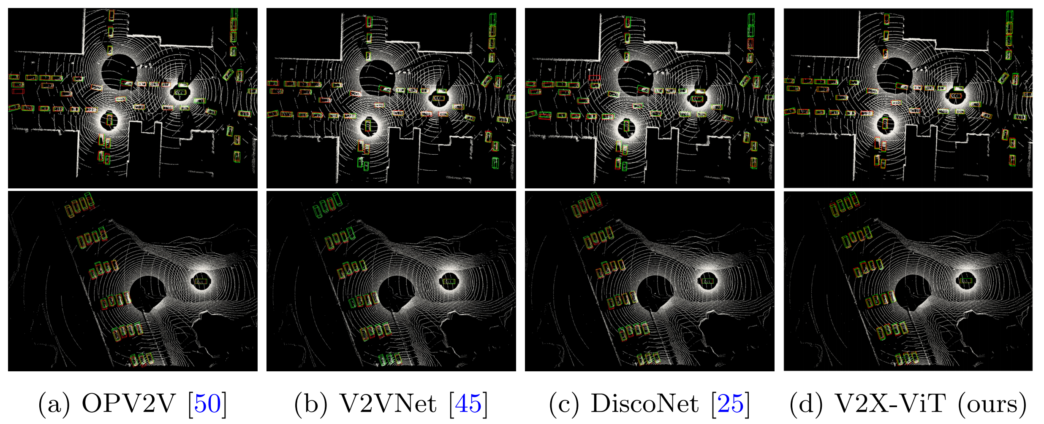
Qualitative evaluation

Slide 27
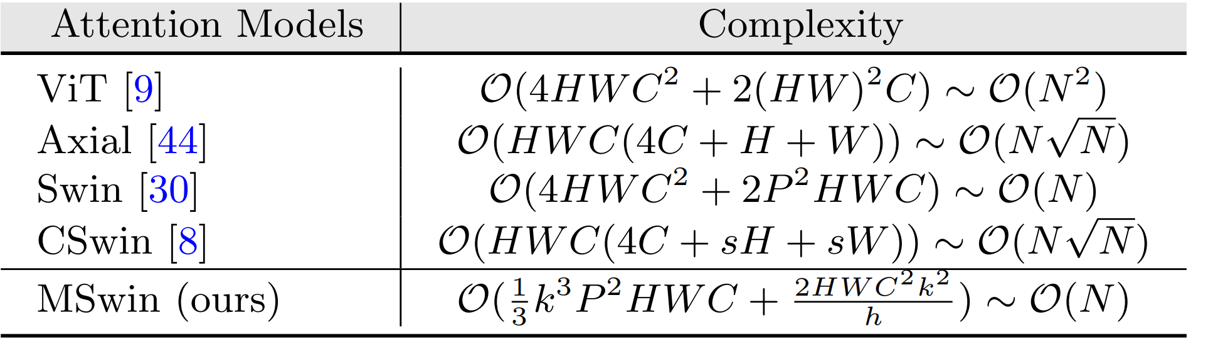
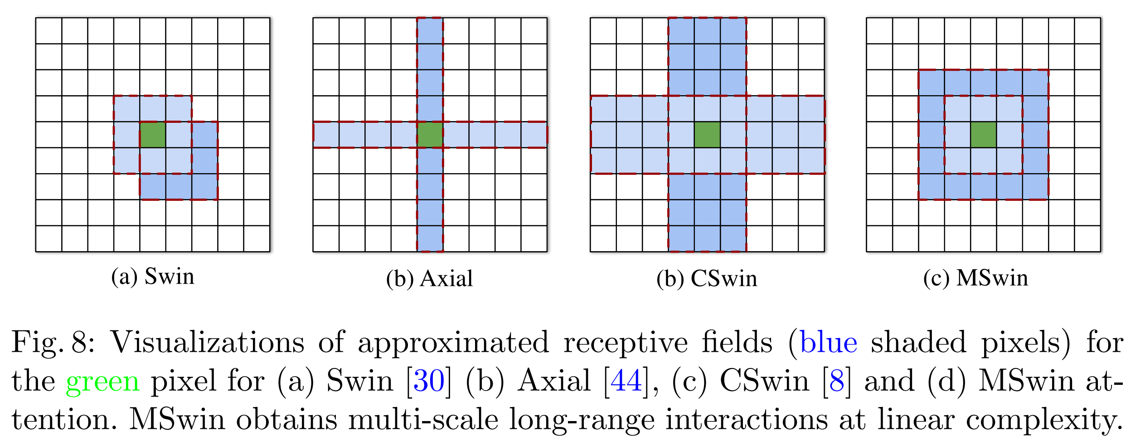
Computation Complexity

Slide 28
Research Gap
Assumed the sensor setups among the same category of agents are identical in HMSA.
The time delay is set to 100 ms for all the evaluated models to have a fair comparison of their robustness against asynchronous message propagation.
Models trained on simulated datasets, there are known issues on data bias and generalization ability to real-world scenarios.
Although the design choice of our communication approach (i.e., project LiDAR to others at the beginning) has an advantage of accuracy, its scalability is limited.
Future research on fairness, privacy, and robustness in visual learning systems for autonomous vehicles

Slide 29
Conclusion
HMSA for adaptive information fusion between heterogeneous agents.
MSwin that simultaneously captures local and global spatial feature interactions in parallel
V2XSet, a new large-scale open simulation dataset for V2X perception, which explicitly accounts for imperfect real-world conditions.
Experiments show that the proposed V2X-ViT significantly advances the performance on V2X LiDAR-based 3D object detection, achieving a 21.2% gain of AP compared to single-agent baseline and performing favorably against leading intermediate fusion methods by at least 7.3%
Compared with existing datasets, V2XSet incorporates both V2X cooperation and realistic noise simulation.

Slide 30
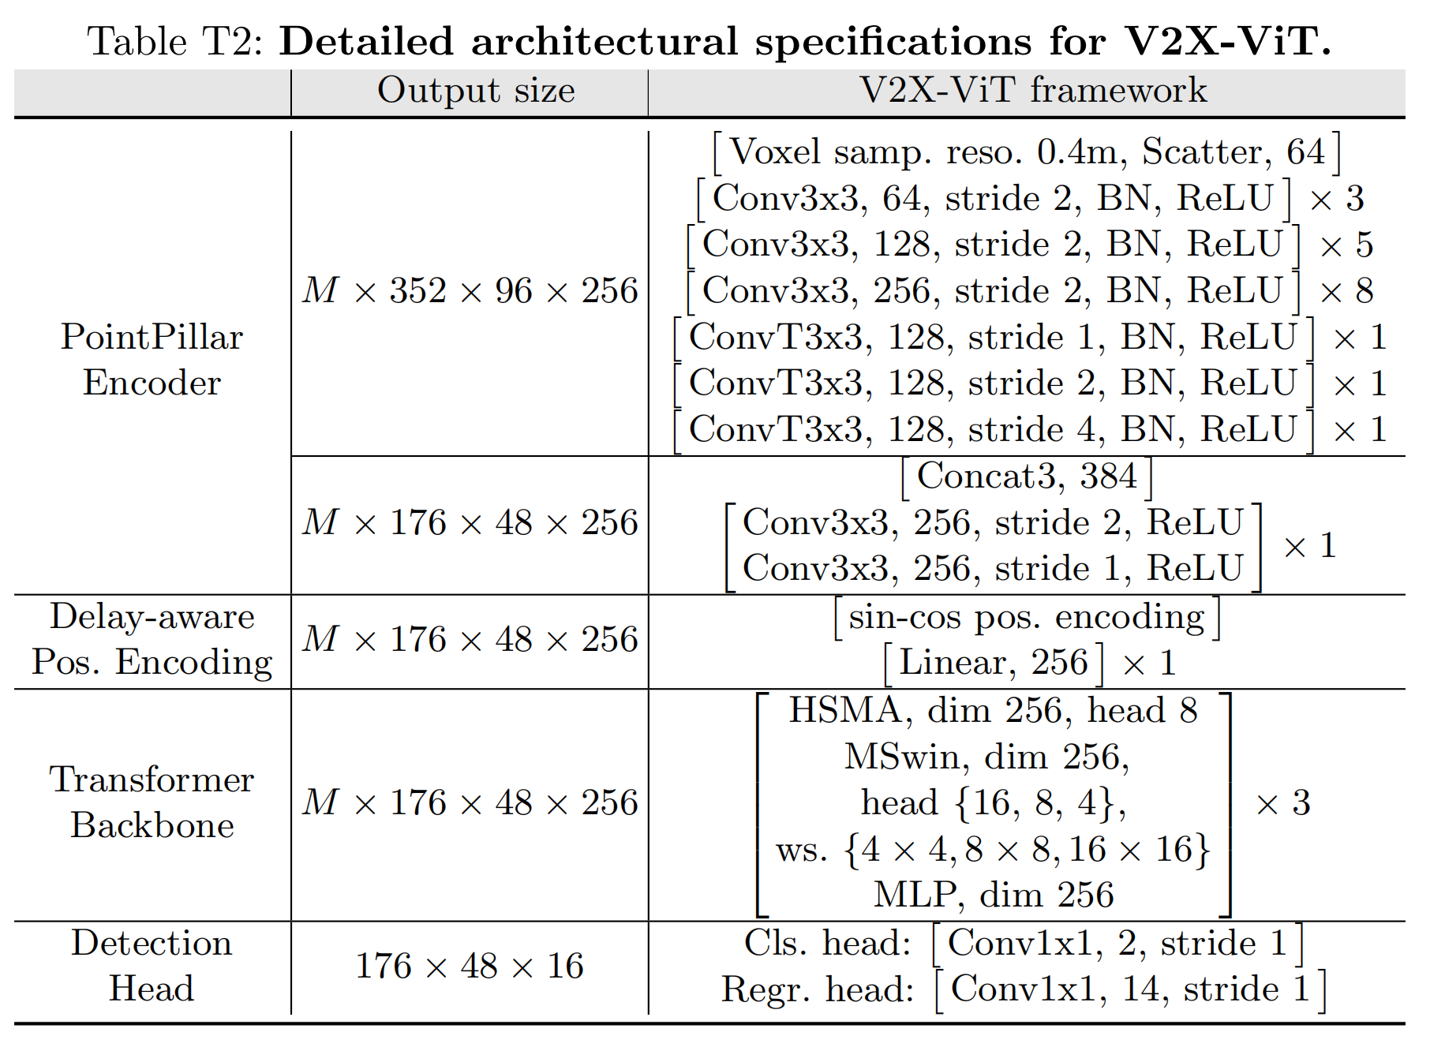
Detailed Architecture

Slide 31
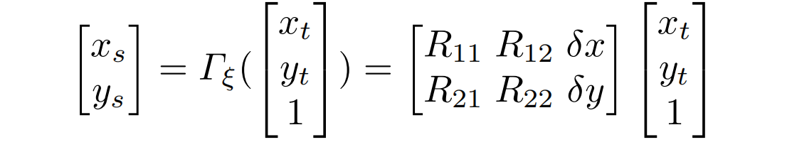
Spatial-Temporal Attention Module
Due to the time delay, the ego vehicle observes the data at a different time t[e]. To correct this misalignment between the received features and ego-vehicle’s features, a global transformation in terms of a differential 2D transformation is applied, to warp the intermediate features spatially.

